Slide 1
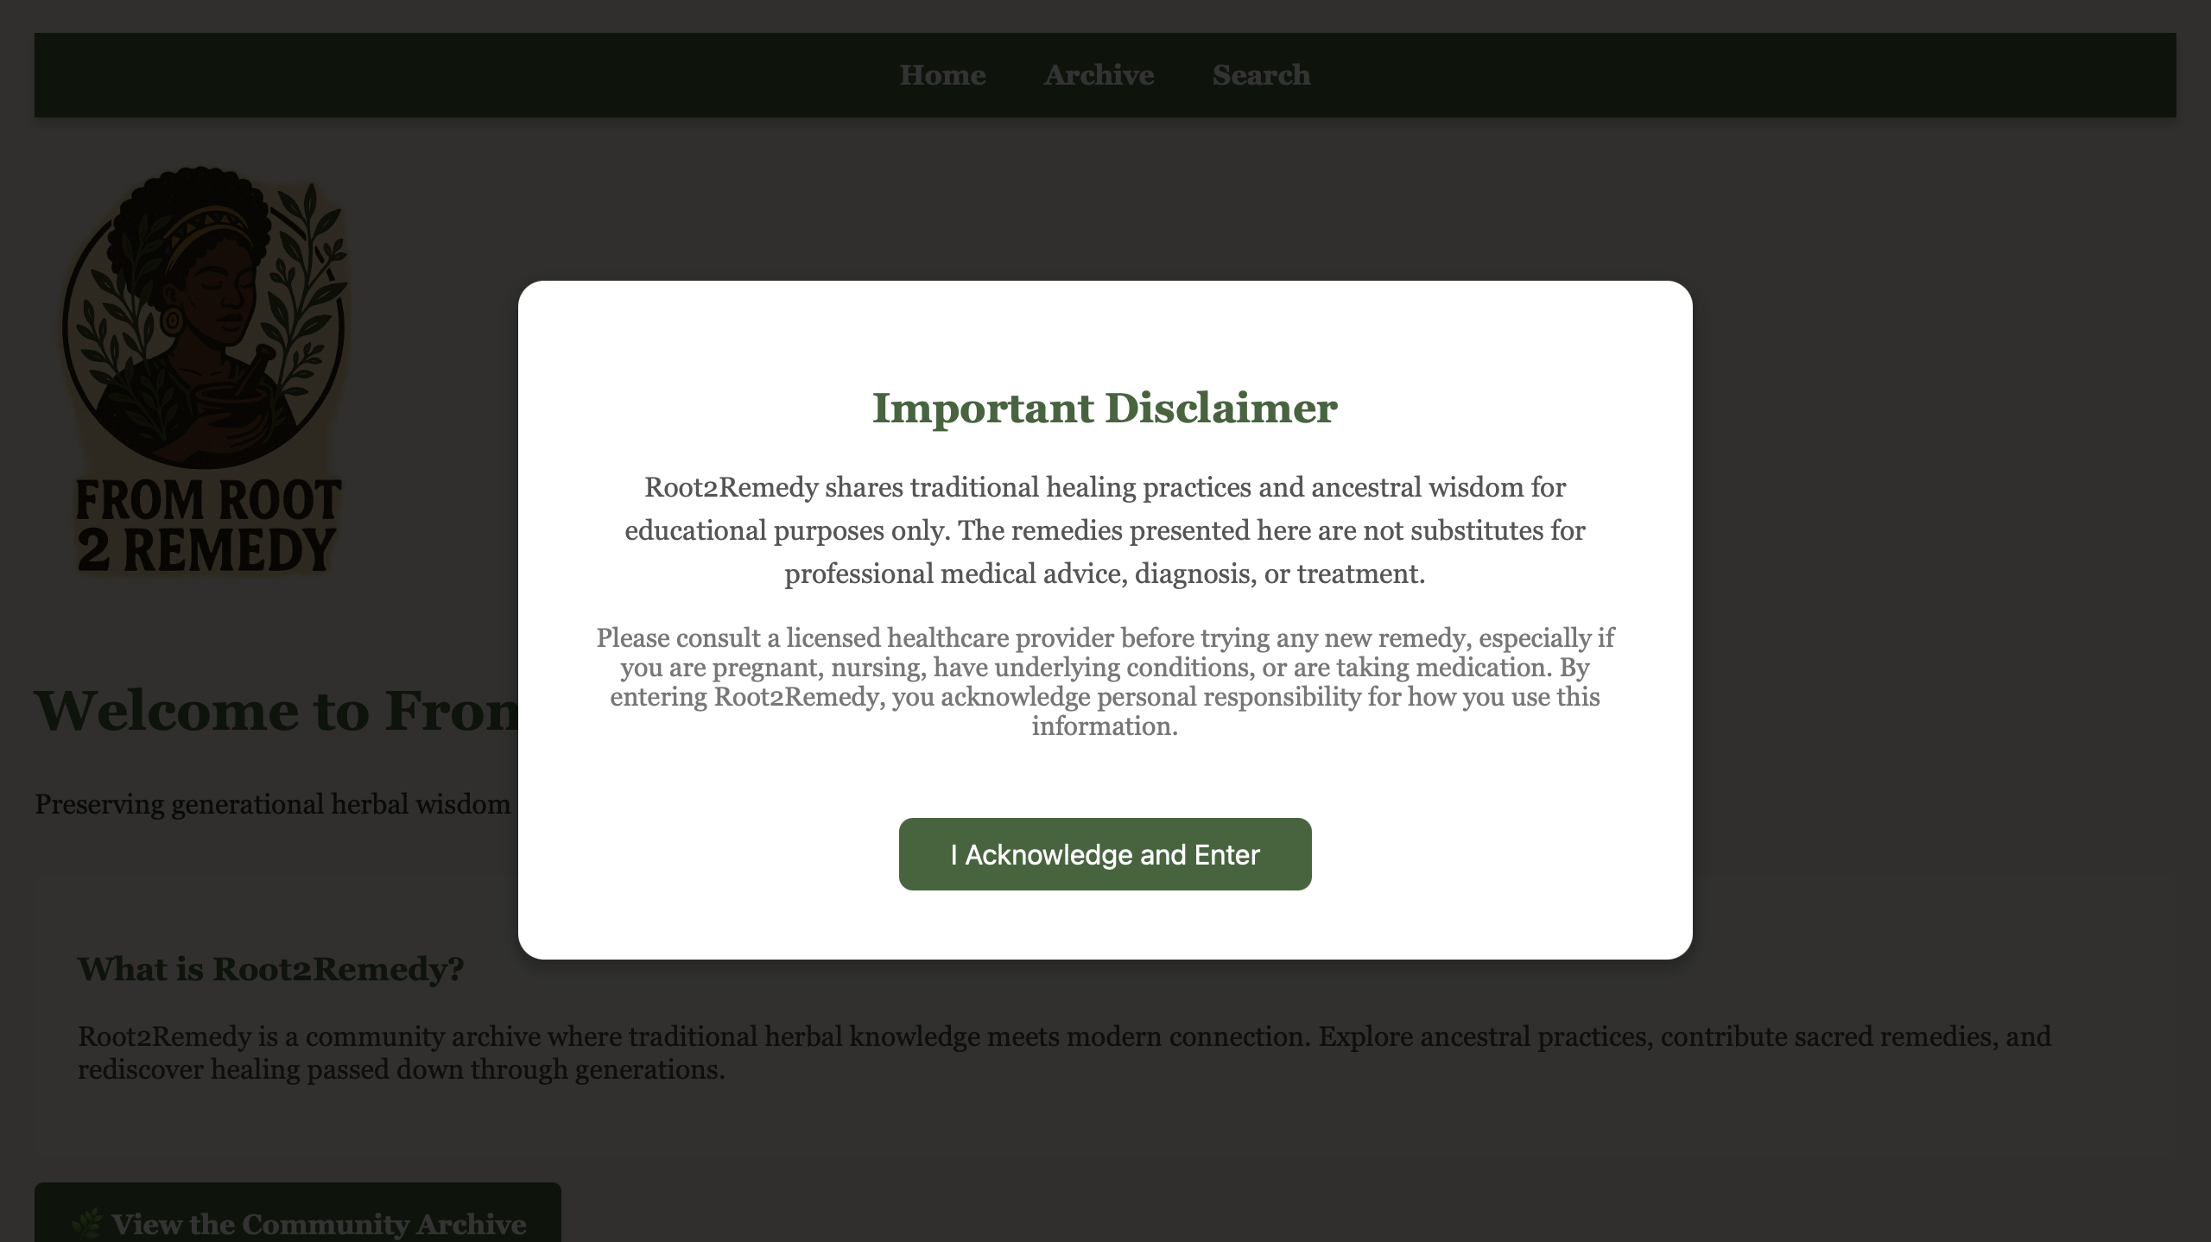
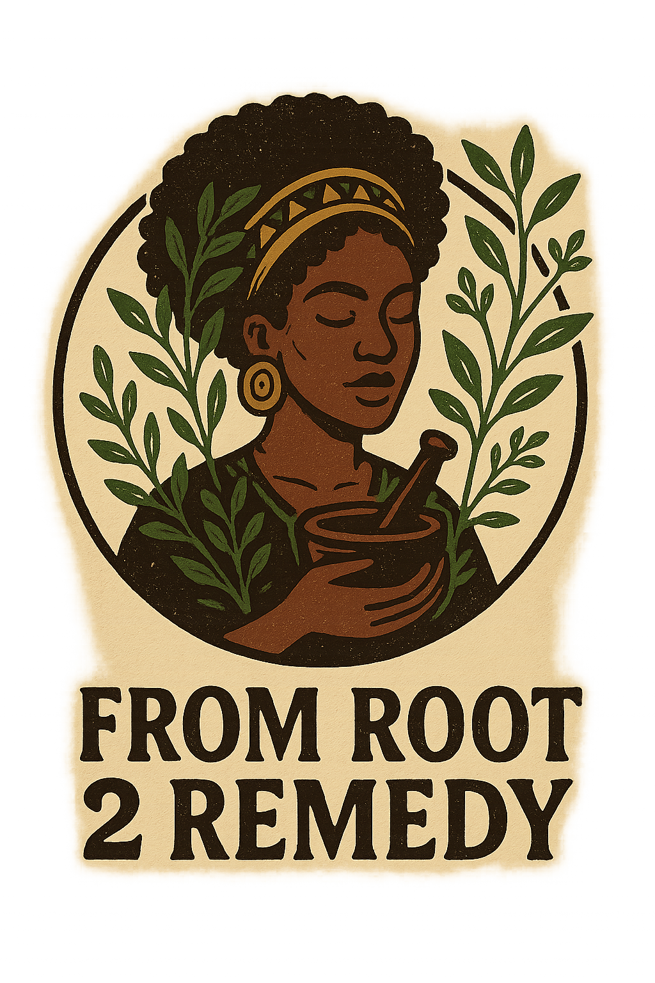
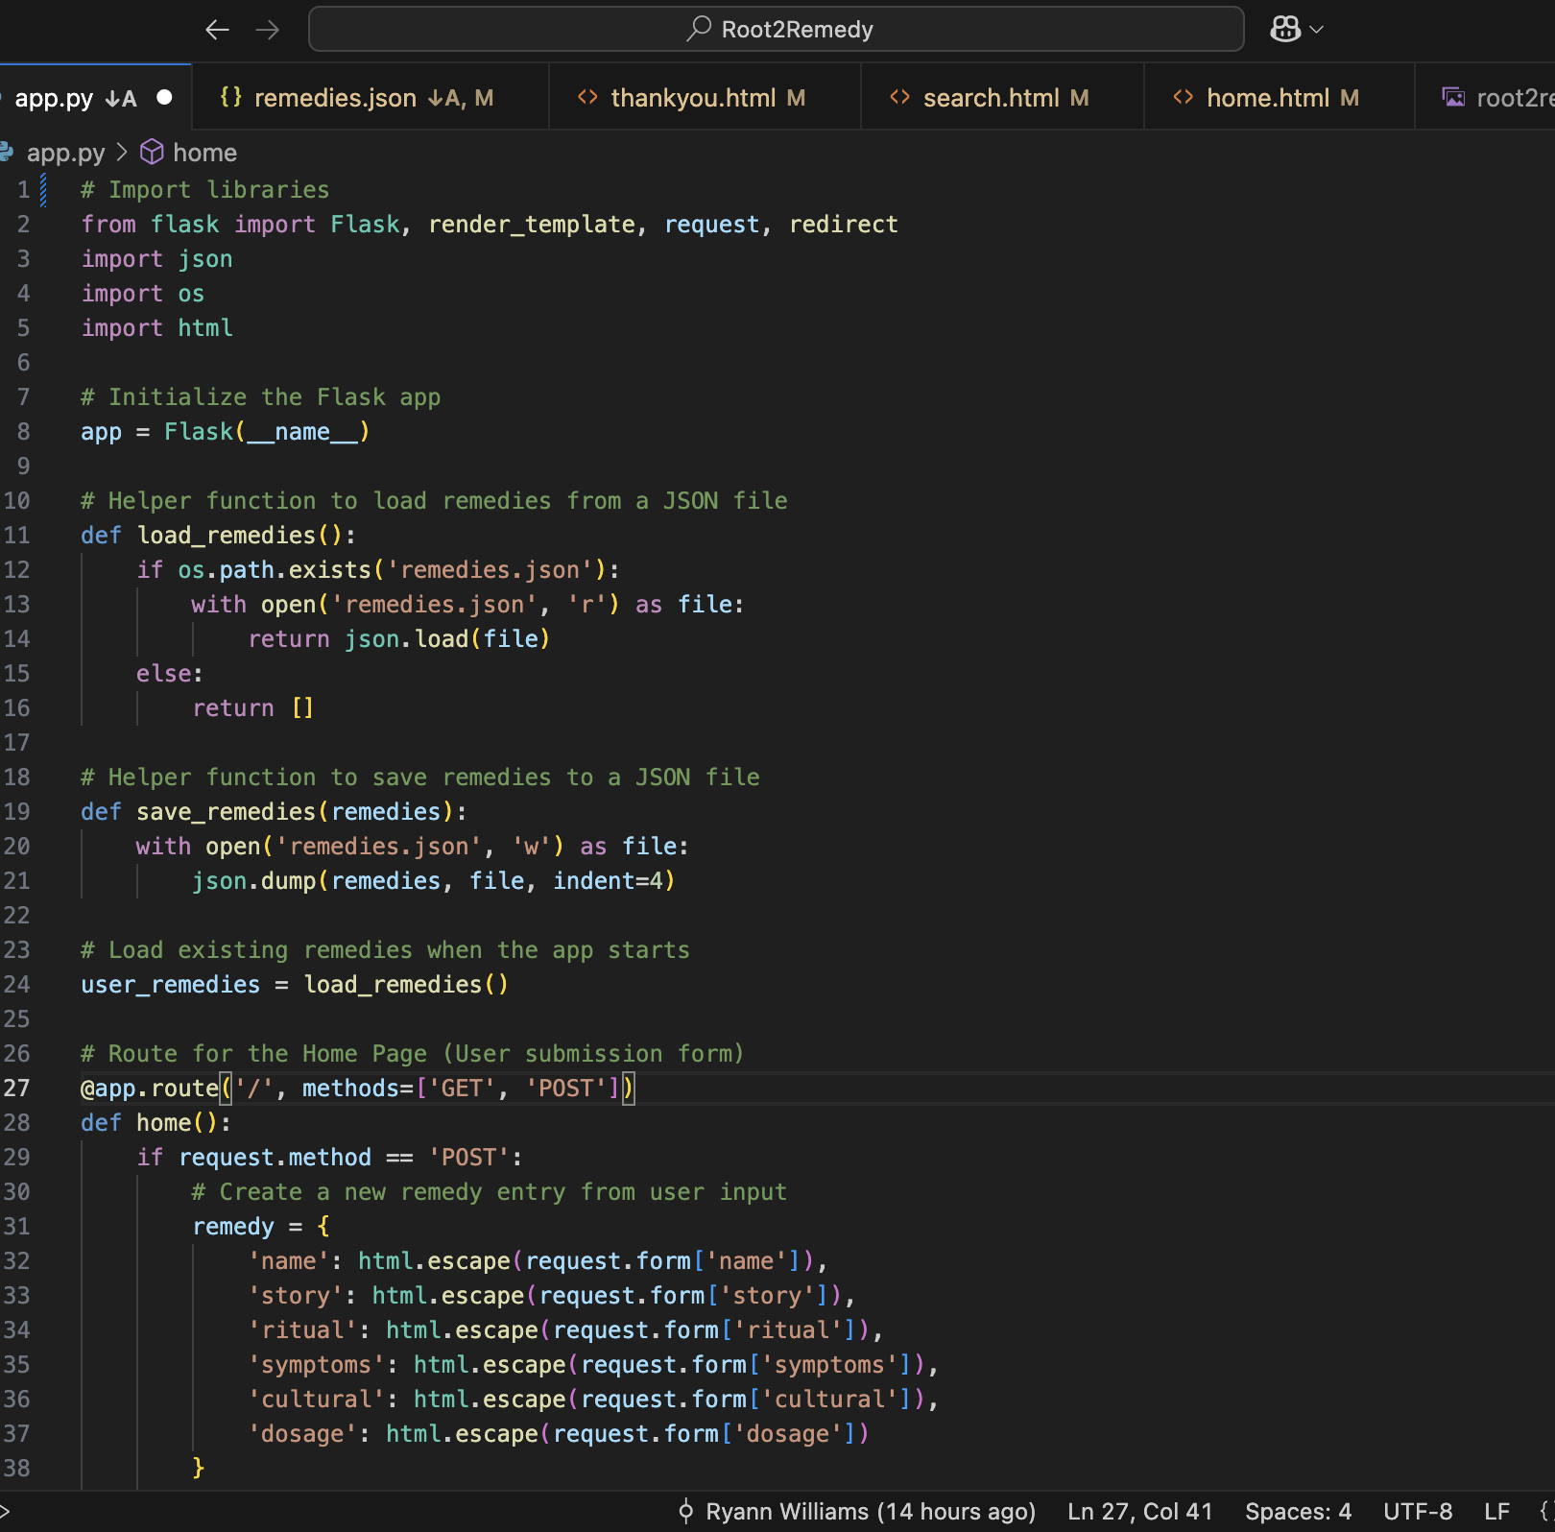
From Root 2 Remedy is a community archive where traditional herbal knowledge meets modern connection. Explore ancestral practices, contribute sacred remedies, and rediscover healing passed down through generations.
🌟 http://From Root 2 Remedy 🌟
From Root 2 Remedy seeks to merge oral tradition with modern technology. Users will have access to an archive of herbal remedies, spiritual rituals, and home-based healing approach, while also having the option to contribute their own.
Coding & Design by Ryann Williams

Slide 2
Root2Remedy- GitHub
I chose this idea because I have always felt a strong connection to traditional / holistic healing and the ancestral wisdom passed down in our communities. In many indigenous households, healing did not always come from a prescription. It came from what was growing in the garden , what your elders taught, or what someone made with intention and care. Because we are moving into a digital age, I wanted to create something that could preserve that legacy. Its important for our generation to keep that knowledge alive, accessible, and respected. From Root 2 Remedy is my way of honoring the past and presenting it in a way that welcomes a community.
From Root 2 Remedy was built with FLASK. A JSON folder was created to extract a dictionary of herbs from a government herbal medicine guide.
Source Code / Tutorials Used:
This repository assisted in creating a JSON file
A repository that helped with inputing remedies
Flask Tutorial (i.e search bar)
GOV. Herbal Supplements Library

